Slide 1
Properties of prisms
Perimeter, area and volume

Slide 2
how to use Oak lessons

Slide 3
I can appreciate that all prisms have two congruent polygonal parallel faces (bases) with parallelogram faces joining the corresponding vertices of the bases.

Slide 4
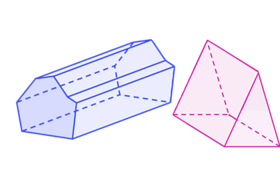
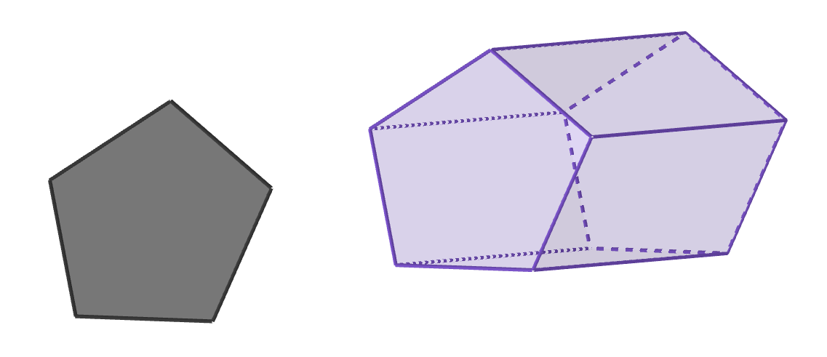
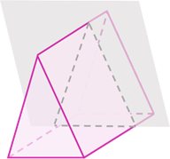
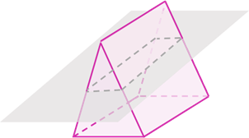
A prism is a polyhedron with a base that is a polygon and a parallel opposite face that is identical. The corresponding edges of the two polygons are joined by parallelograms.
prisms
A cross section is a 2D face made from cutting straight through any plane of a 3D object.
cross sections
A cross section of a prism made parallel to the base will be congruent to the base.

Slide 5
Faces are the flat 2D surfaces of a 3D shape.
Two lines are parallel if they are straight lines that are always the same (non-zero) distance apart.
If one shape can fit exactly on top of another using rotation, reflection or translation, then the shapes are congruent.
Uniform means unchanging. Prisms have uniform cross sections which means that the cross sections (cut parallel to the base) along the prism remain constant in size and shape.

Slide 6

Properties of prisms
Defining a prism
Categorising prisms

Slide 7
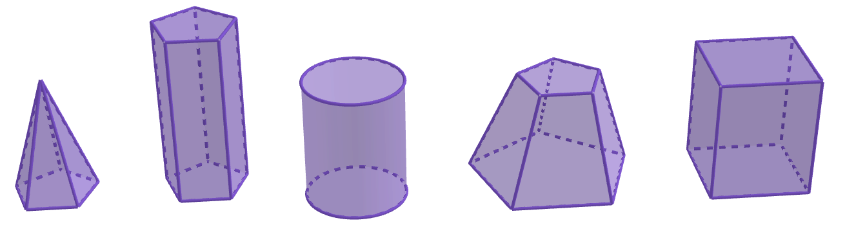



Defining a prism
Which of these 3D shapes do you think is a prism?
a
b
d
e
c
What properties make b and e prisms, whilst the others not?

Slide 8
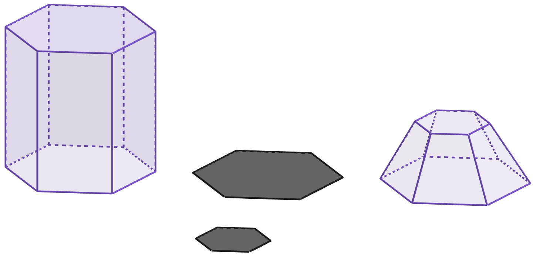
Defining a prism
For a 3D shape to be a prism, any cross section taken parallel to the base must be: exactly the same, uniform 2D shape to any other cross section taken parallel to the first.
The polygon at the top of this 3D shape is much smaller than the
polygon at the bottom.
As these parallel, cross sectional shapes are not congruent, it is not a prism.
example of a prism
non-example of a prism

Slide 9
Defining a prism
Only cross sections parallel to the base have to be congruent.
Two cross sections that are not parallel do not need to be congruent.
Cross sections parallel to the base are congruent.
These two hexagons are not congruent because they are not parallel.

Slide 10
Defining a prism
Note that only cross sections parallel to the base taken in one direction have to be congruent to each other.
Cross sections parallel to the base are congruent.
Cross sections in any other direction don’t need to be congruent for it to be a prism.

Slide 11
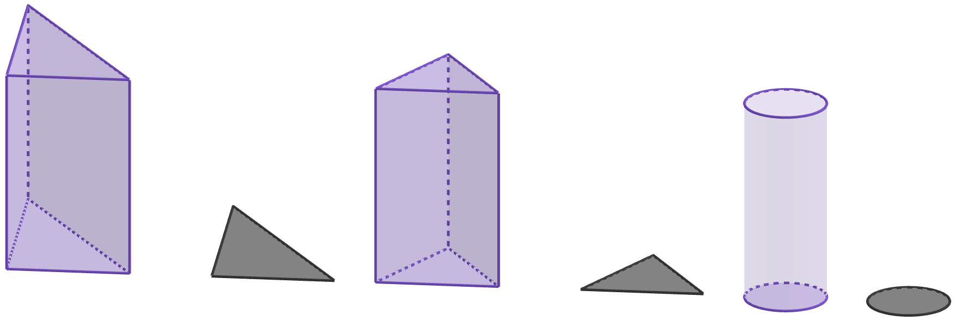
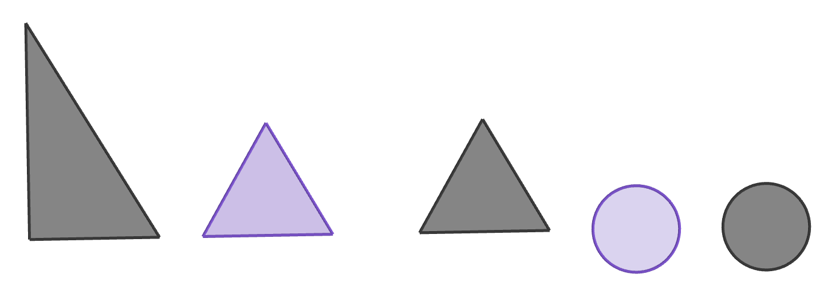
Defining a prism
The 2D cross sectional shapes must be a polygon.
This prism has equilateral triangles as its cross sectional polygon.
This cylinder has congruent circles as its cross sectional shape.
example of a prism
non-example of a prism
circles are not polygons

Slide 12

Defining a prism
All other non-cross sectional faces of a prism must be parallelograms.
In right prisms, these faces are all rectangles.
These faces are trapezia, not parallelograms.
All of these faces are rectangles
Therefore, this object is not a prism.

Slide 13
Defining a prism
Sometimes a prism can have regular polygons, like this equilateral triangle.
And other times, a prism can have irregular polygons, like this scalene triangle.

Slide 14
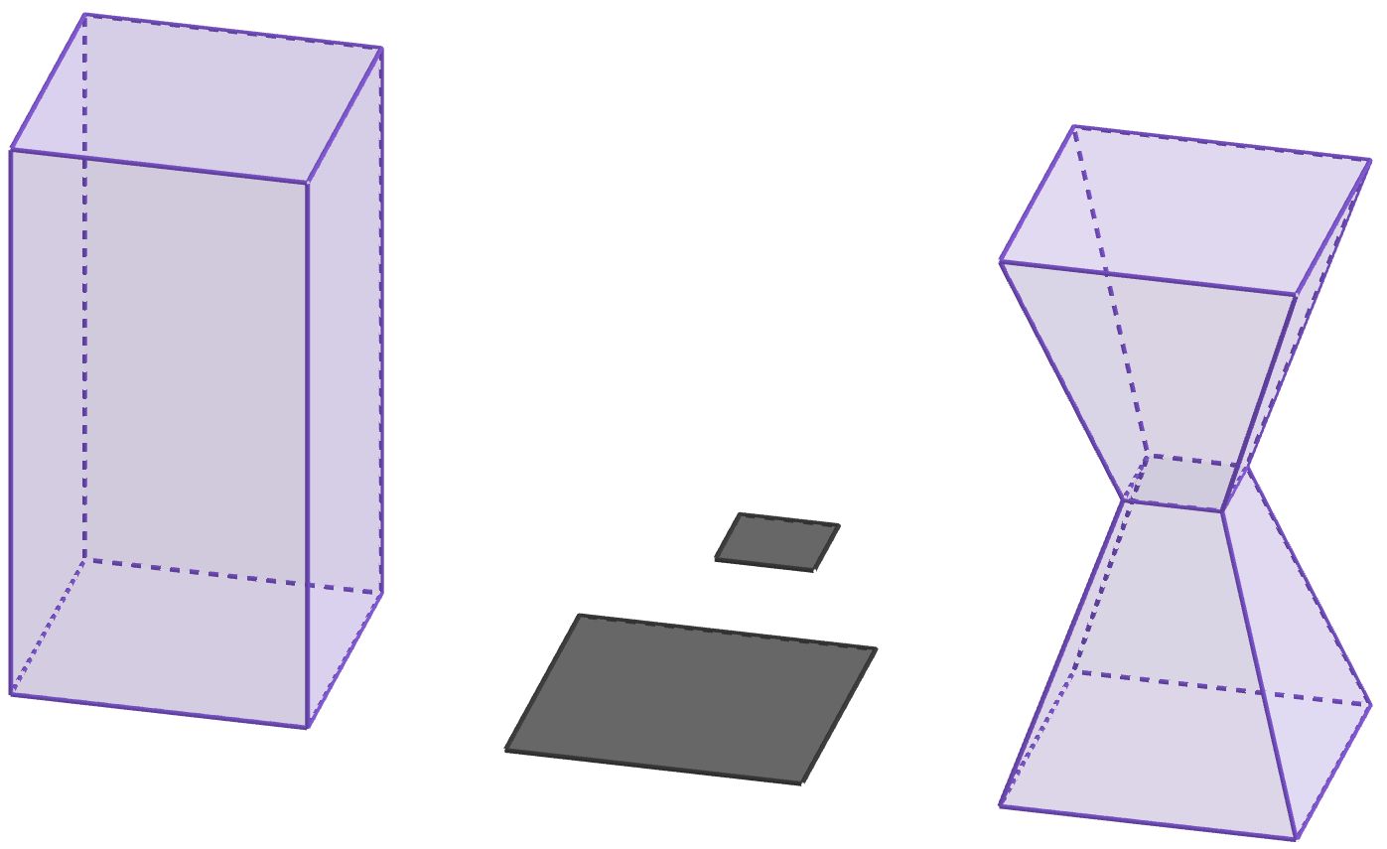
Defining a prism
To be a prism, the cross section must be uniform throughout the entire length of the shape. It is not enough to compare just the two faces at the opposite ends of the shape.
This prism has a uniform cross section. The rectangles are congruent throughout.
This object has congruent rectangles at the very top and bottom of the shape.
However, the cross sectional rectangle at the centre is much smaller.
Therefore, this is not a prism.

Slide 15
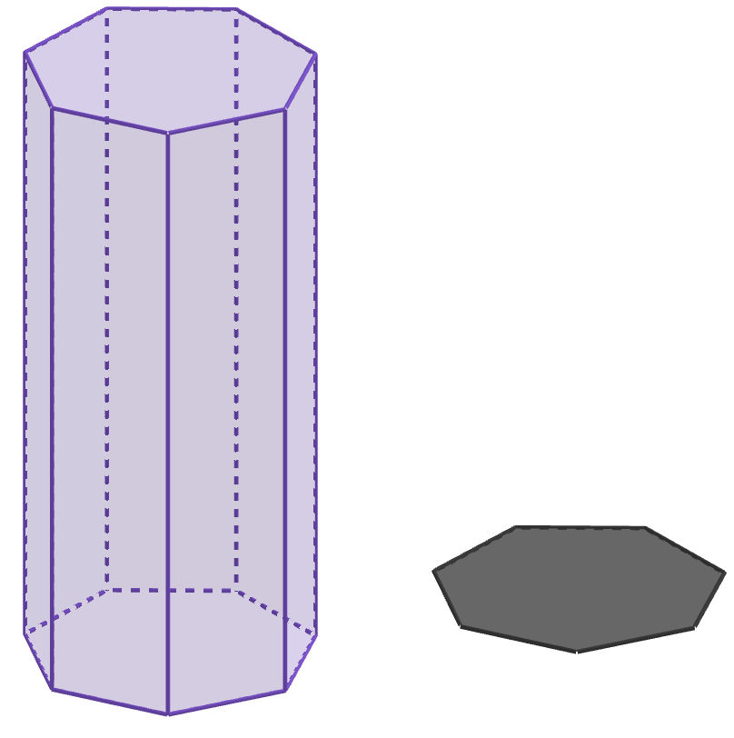
Defining a prism
This 3D shape is a prism.
These four 2D shapes were used to help identify the shape as a prism.
Which of these words and phrases must be true to describe these four 2D shapes?
a
circles
d
parallel
b
congruent
e
equal distance apart
c
different sizes
f
polygons

Slide 16
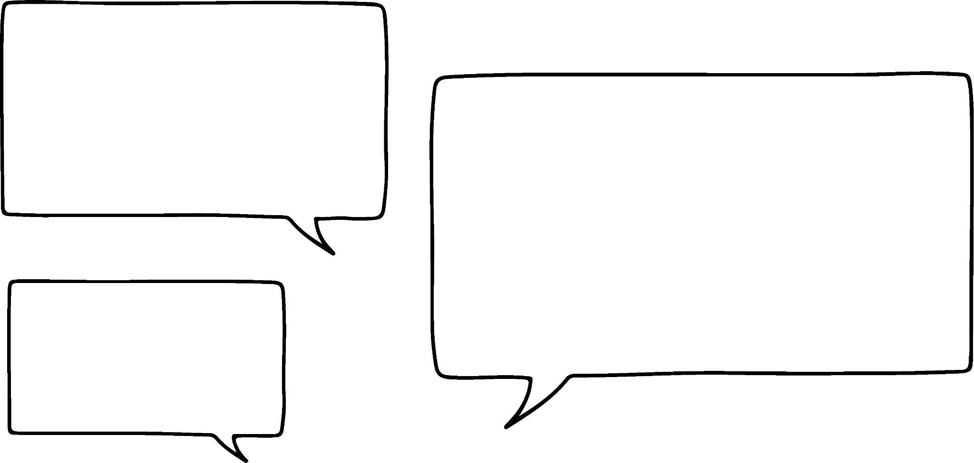
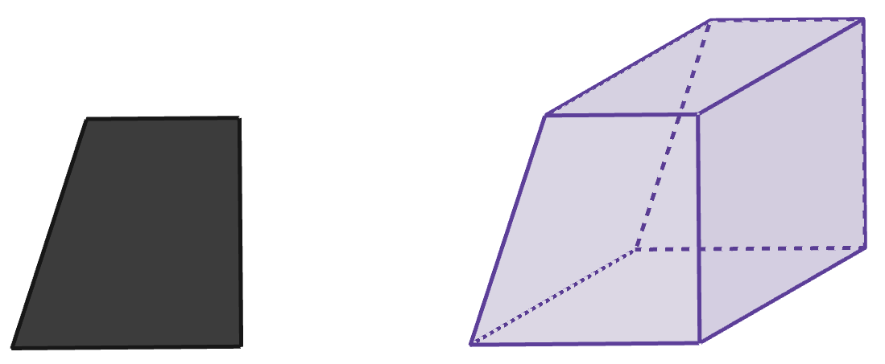

Defining a prism
Izzy
This 3D shape is not a prism, because the cross sections aren’t all congruent to each other!
Which of these statements best describes why Izzy is incorrect?
a
The cross sections aren’t parallel to each other.
b
The cross sections haven’t been taken in the correct direction.
c
The cross sections have to be at the faces of the 3D shape.

Slide 17
Defining a prism
Izzy
This 3D shape is not a prism, because the cross sections aren’t all congruent to each other!
b
The cross sections haven’t been taken in the correct direction.
Parallel cross sections of a prism have to be congruent, but only in one direction of the shape.
If two parallel cross sections aren’t congruent, the shape will still be a prism if all the polygonal cross sections are congruent in a different direction.
Cross sections can be anywhere along a 3D shape, not just at the faces.

Slide 18
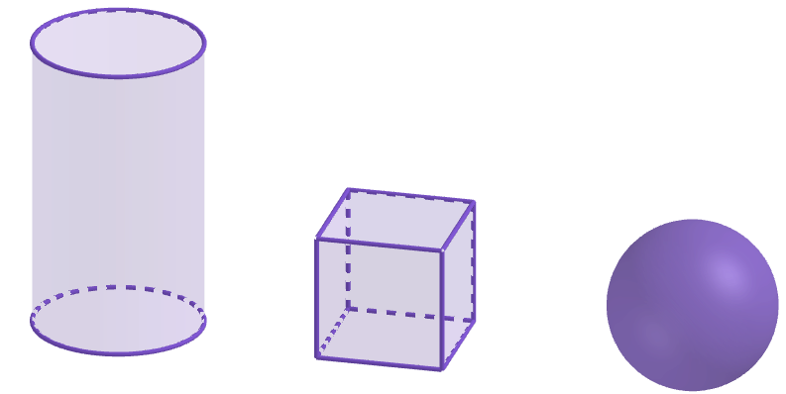
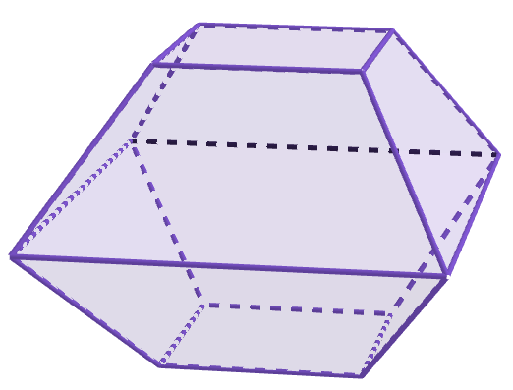
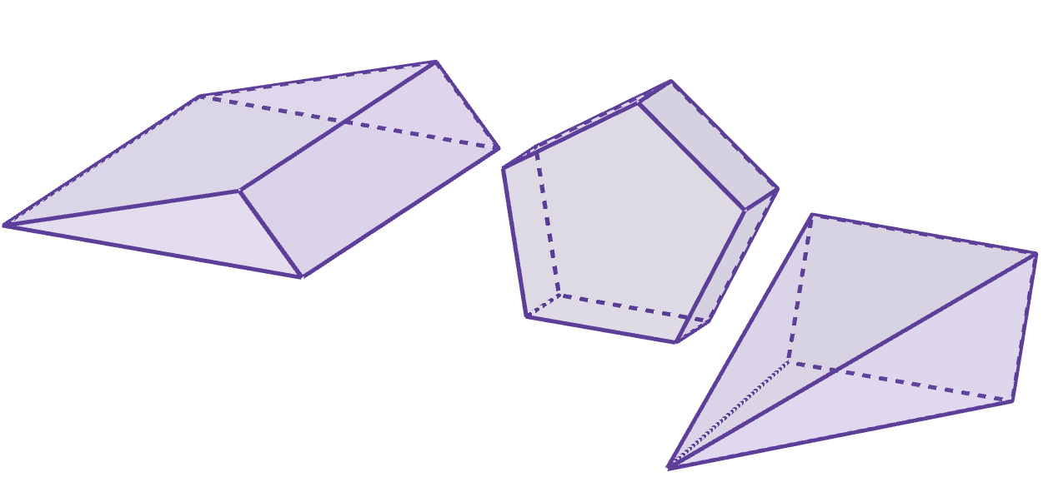
Defining a prism
1) Which of these match the properties of a prism?
b
c
d
a
e
g
f

Slide 19
Defining a prism
2) Complete the sentences with the missing words provided to give an explanation of what a prism is.
A prism is a object.
All of its 2D cross sections must be .
In at least one direction, all cross sections must
be to each other.
2D
circular
parallel
congruent
3D
polygons
perpendicular
equidistant

Slide 20
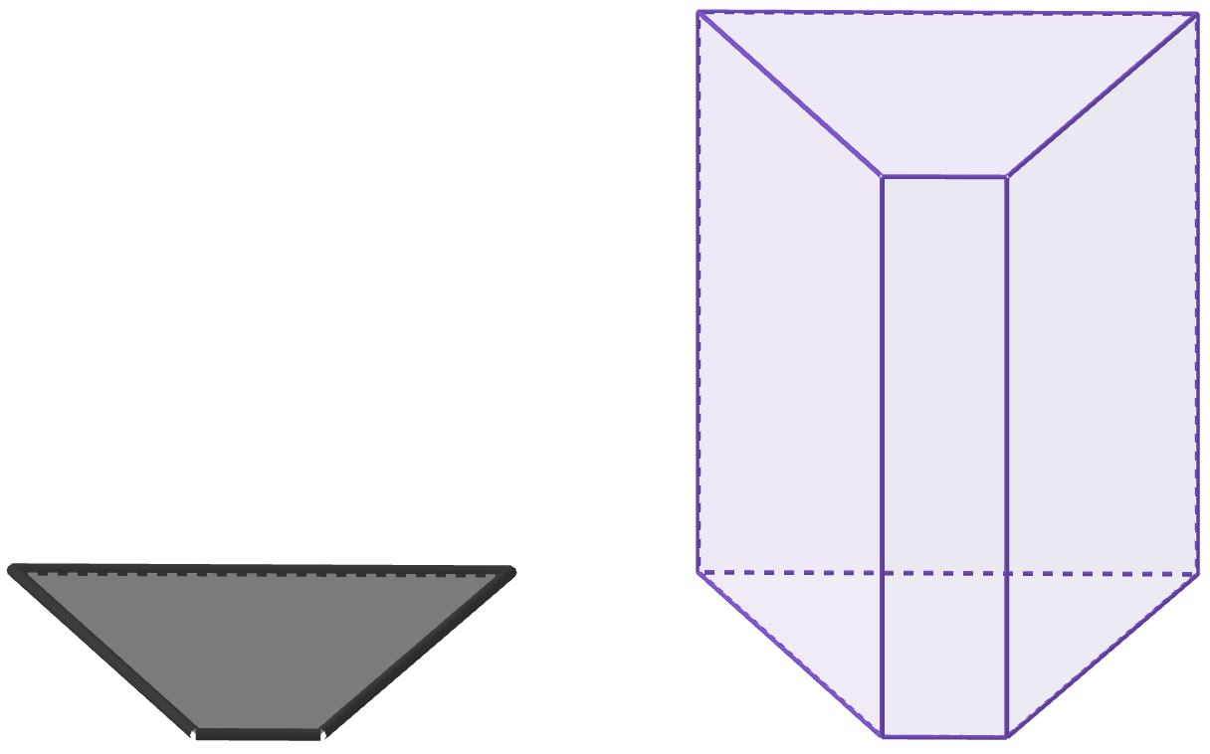
Defining a prism
3) These diagrams all show the same prism.
Which of the diagrams show the correct cross sections that help demonstrate it is a prism? Explain how you know.
a
b
c

Slide 21
Defining a prism
1) Which of these match the properties of a prism?
b
c
d
a
e
g
f

Slide 22
Defining a prism
2) Complete the sentences with the missing words provided to give an explanation of what a prism is.
3D
A prism is a object.
All of its 2D cross sections must be .
In at least one direction, all cross sections must
be to each other.
polygons
parallel
congruent
2D
circular
perpendicular
equidistant

Slide 23
Defining a prism
3) These diagrams all show the same prism.
Which of the diagrams show the correct cross sections that help demonstrate it is a prism? Explain how you know.
a
b
c

Slide 24
Defining a prism
3) These diagrams all show the same prism.
Which of the diagrams show the correct cross sections that help demonstrate it is a prism? Explain how you know.
a
These cross sections:
are polygons
are parallel to each other
are not congruent
Therefore, these cross sections do not help demonstrate this is a prism.

Slide 25
Defining a prism
3) These diagrams all show the same prism.
Which of the diagrams show the correct cross sections that help demonstrate it is a prism? Explain how you know.
b
These cross sections:
are polygons
are parallel to each other
are congruent
Therefore, these cross sections help demonstrate this is a prism.

Slide 26
Defining a prism
3) These diagrams all show the same prism.
Which of the diagrams show the correct cross sections that help demonstrate it is a prism? Explain how you know.
c
These cross sections:
are polygons
are not parallel to each other
are congruent
Therefore, these cross sections do not help demonstrate this is a prism.

Slide 27
Properties of prisms
Defining a prism
Categorising prisms

Slide 28
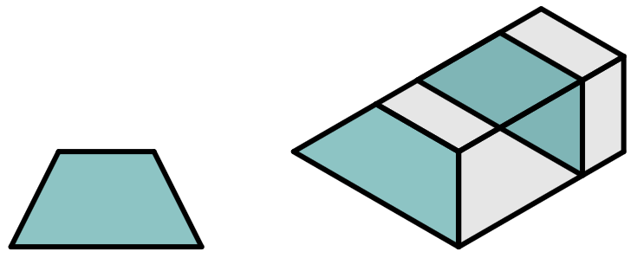
Categorising prisms
How do we name the different types of prism?
We take the face or cross section that is uniform throughout the shape,
and look at its shape and properties.
This is a quadrilateral.
Specifically, it is a trapezium.
Therefore, we can call this a:
quadrilateral prism or
trapezium-based prism

Slide 29
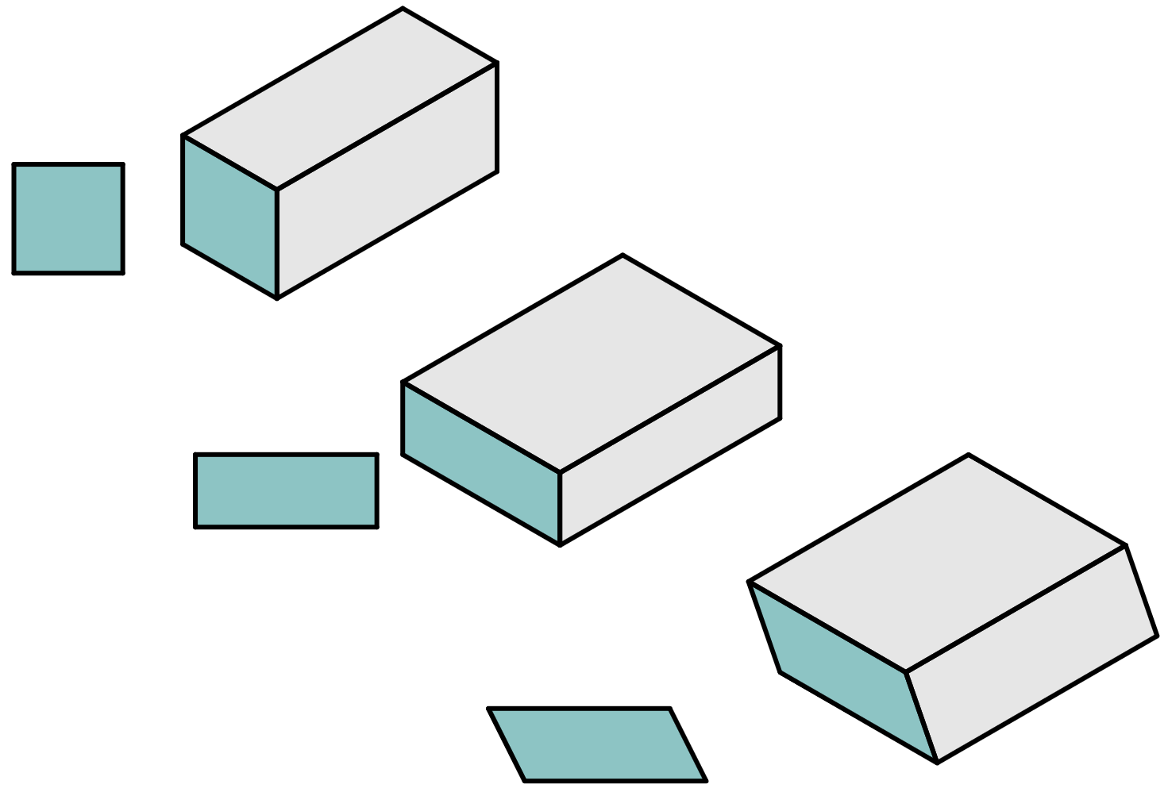
Categorising prisms
The name of the prism also usually specifies whether the cross sectional polygon is regular or not.
In the case of quadrilaterals, we have:
square-based
prism
rectangular
prism
parallelogram-based prism

Slide 30
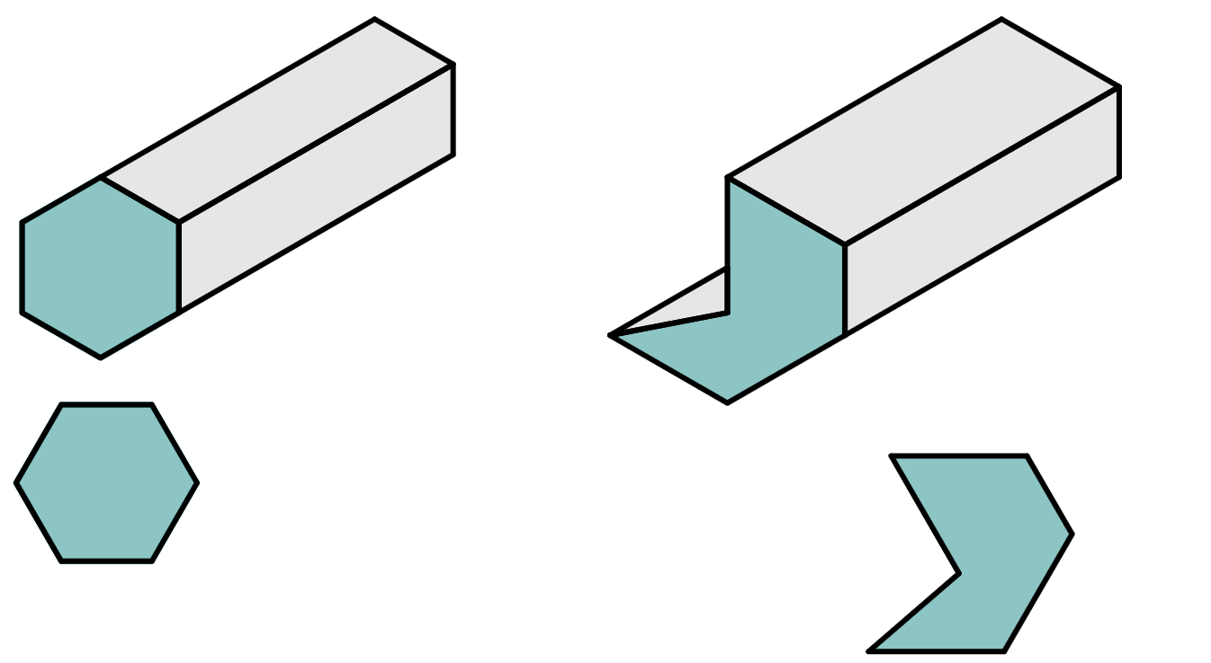
Categorising prisms
The name of the prism also usually specifies whether the cross sectional polygon is regular or not.
For other polygons, we have examples, such as:
regular hexagonal
prism
hexagonal
prism

Slide 31
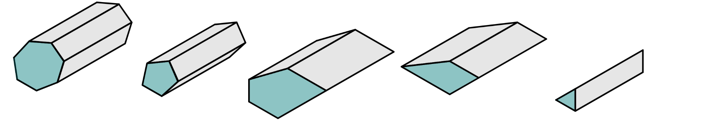
Categorising prisms
Match the prism to its name.
1
regular heptagonal prism
2
pentagonal prism
a
b
3
trapezium prism
c
4
regular pentagonal prism
5
equilateral triangle prism
e
d

Slide 32
Categorising prisms
Match the prism to its name.
1
regular heptagonal prism
d
2
pentagonal prism
b
a
b
3
trapezium prism
c
e
4
regular pentagonal prism
a
5
equilateral triangle prism
e
d
c

Slide 33
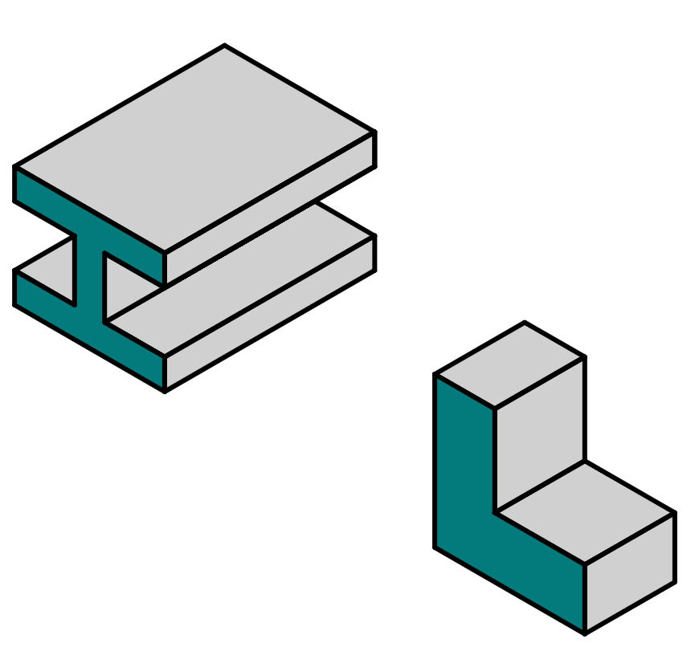
Categorising prisms
Prisms are used in many different contexts, including construction.
Here are some common examples.
L-frame
I-beam
In a construction setting, I-beam and L-frame would be their preferred names.

Slide 34
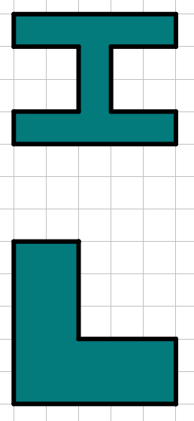
Categorising prisms
However, they can also still be described using their cross sectional polygon.
If the number of sides of the prism is tricky to see in a 3D view, you can always sketch the 2D cross sectional polygon first and count the number of sides.
dodecagon
hexagon
hexagonal prism
I-beam
L-frame
dodecagonal prism

Slide 35
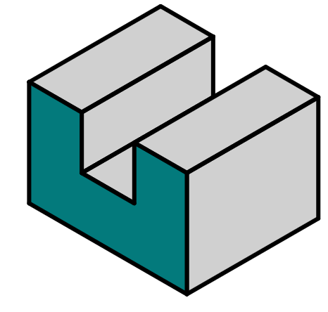
Categorising prisms
By sketching the cross sectional polygon of this prism, count how many sides the cross sectional polygon has.
8 sides

Slide 36
Categorising prisms
What would the name of this prism be?
a
U-beam prism
b
hexagonal prism
c
regular hexagonal prism
d
octagonal prism
e
regular octagonal prism

Slide 37
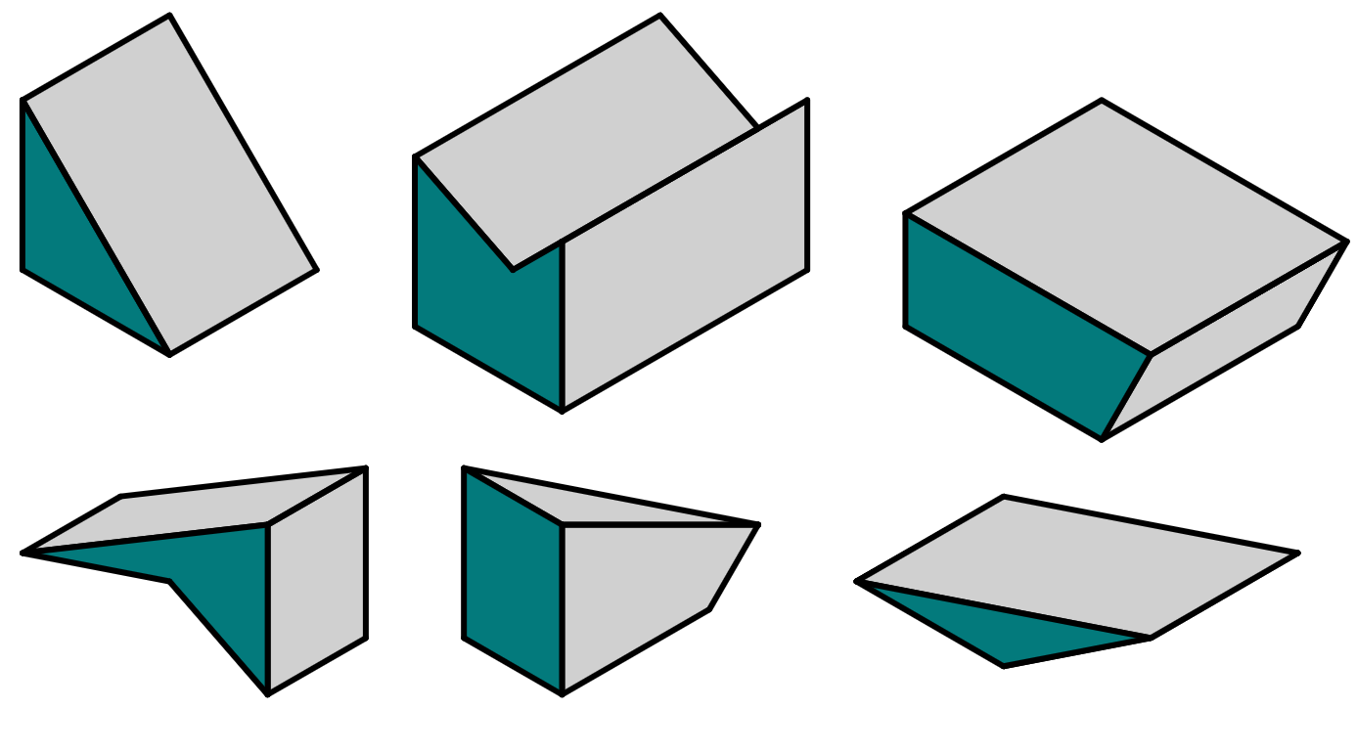
Categorising prisms
1) Place these 3D shapes into the correct row in the table.
triangular prism
quadrilateral prism
pentagonal prism
not a prism
a
b
c
d
e
f

Slide 38
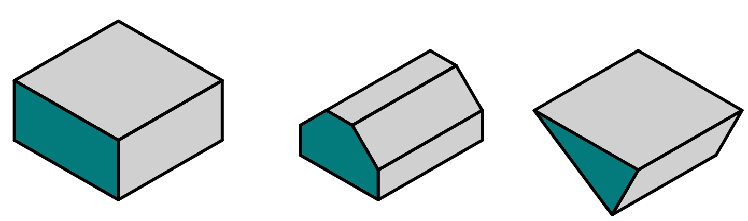
Categorising prisms
2) On squared paper, sketch the cross sectional polygon for each of these prisms.

Slide 39
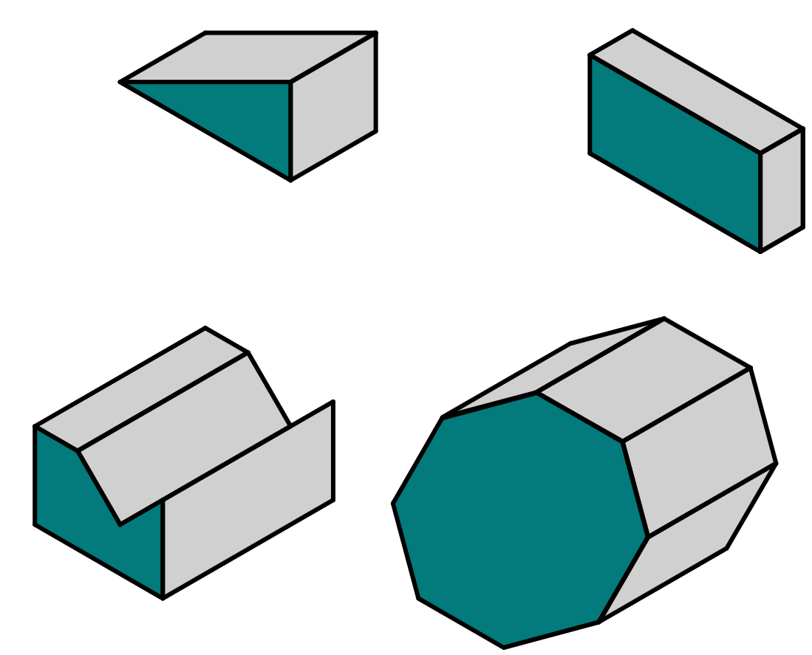

Categorising prisms
3) Write down a suitable name for each prism.
a
b
e
d
c

Slide 40
Categorising prisms
1) Place these 3D shapes into the correct row in the table.
triangular prism
quadrilateral prism
pentagonal prism
not a prism
a
b
a
f
c
c
d
b
d
e
f
e

Slide 41
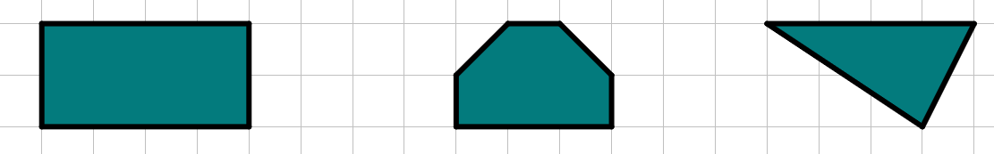
Categorising prisms
2) On squared paper, sketch the cross sectional polygon for each of these prisms.
These are only approximate shapes - if your sketch differs slightly, that is okay.

Slide 42
Categorising prisms
3) Write down a suitable name for each prism.
a
a
triangular prism
right-angled triangular prism
b
b
quadrilateral prism
rectangular prism
d
c
hexagonal prism
irregular hexagonal prism
c
d
octagonal prism
regular octagonal prism
If you came up with a different answer, can you justify it?

Slide 43
Categorising prisms
3) Write down a suitable name for each prism.
e
octagonal prism
irregular octagonal prism
e
If you came up with a different name for any prism, can you justify it?

Slide 44
Properties of prisms
Understanding the properties of a prism make it easier to identify prisms from non-prisms.
Knowing that prisms are usually identified by the shape and properties of its cross-sectional polygon allow for naming and categorising of prisms.
Appreciating that there are two types of prism: right and oblique, broadens understanding of what can be identified as a prism.

Slide 45

© Oak National Academy 2023.
Produced in partnership with Mathematics in Education and Industry.
Licensed on the Open Government Licence v3.0, except where otherwise stated. See Oak terms and conditions.

